Slide 1
EMBT-ESE 4009
Interfacing with spo2 Project topic:Health monitoring device using IOT -connected headphone.
Group Number : 2
Group Members:
Christy Rachel Philip
Fahad Rahman
James M. Chacko
Premil Prasannan
Instructor : Mike Aleshams
Presented by,
Fahad Rahman

Slide 2
Contents
Introduction
Overview of project
Engineering drawing
Block diagaram
About Spo2 sensor
Spo2 sensor specifications
Spo2 sensor interfacing
Source code and connections
Conclusion

Slide 3
Introduction
This presentation is all about the specification and interfacing of Spo2 sensor
in Health monitoring device
In this Project, we will try to make a Smart Health Monitoring Device that can measure SpO2 (percentage of oxygen in the blood) and heart rate in BPM (Beat Per Minute). This wearable device can be used by anyone to monitor their heart rate and blood oxygen levels. The Best part of this project is that we can connect this device to an Android app Blynk that will record and regularly update the data for both SPO2 & BPM on the internet. Even anyone can monitor the data from any part of the world as data are uploaded on server.

Slide 4
Introduction
.As there is an availability of online data, so this project can be used to monitor the health of a patient online. The pulse oximeter available in the market is very expensive, but with this simple & low-cost pulse oximeter module, we can make our own device. With MAX30100 Pulse Oximeter with ESP32..

Slide 5
An Overview of the Project.
The topic of our project is “Health monitoring device using IOT-connected headphone.”
Our Project is an IoT-connected health care device, which is connected as a part of Bluetooth headphones. It consists of surface electrodes, temperature sensors, GPS, etc., to obtain various health-related data such as heartbeat rate, temperature, and EKG.
The device can be connected to a mobile phone through IoT. The user's information such as height, weight and previous history should be saved in the application. Using this, the family doctor can access it directly to monitor the patient's condition every day and communicate with them. Along with this, it has a push-button as well, so in case of emergencies, patient’s can press it by themselves and send information to 911 and doctor.

Slide 6
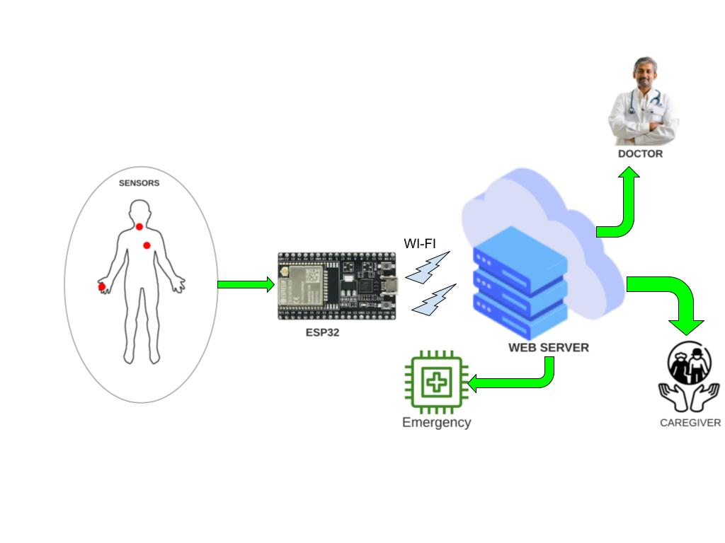
Engineering Drawing

Slide 7
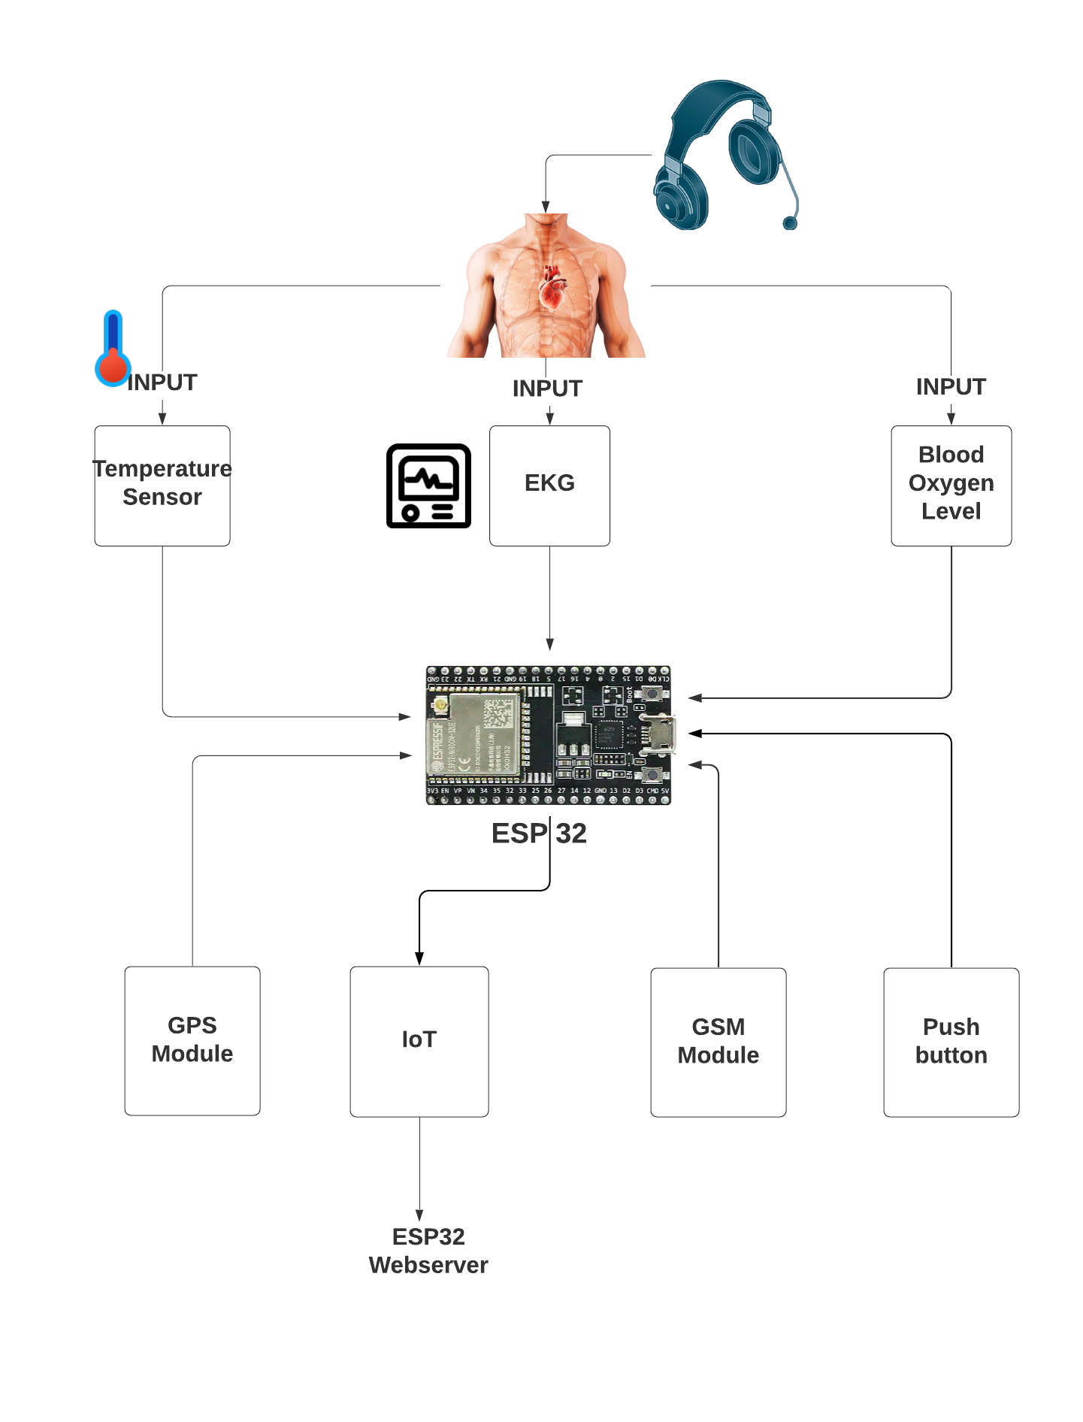
Block Diagram

Slide 8
MAX30100 Pulse Oximeter
The sensor is integrated pulse oximetry and heart-rate monitor sensor solution. It combines two LED’s, a photodetector, optimized optics, and low-noise analog signal processing to detect pulse and heart-rate signals. It operates from 1.8V and 3.3V power supplies and can be powered down through software with negligible standby current, permitting the power supply to remain connected at all times.

Slide 9
MAX30100 Pulse Oximeter
Features of MAX30100 Pulse Oximeter
1. Consumes very low power (operates from 1.8V and 3.3V)
2. Ultra-Low Shutdown Current (0.7µA, typ)
3. Fast Data Output Capability

Slide 10
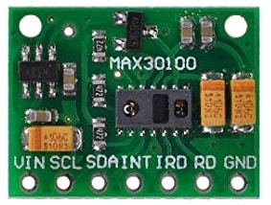
ESP32 Microcontroller Board
￼
￼
￼

Slide 11
Working of MAX30100 Pulse Oximeter and Heart-Rate Sensor
￼
￼
￼
The device has two LEDs, one emitting red light, another emitting infrared light. For pulse rate, only the infrared light is needed. Both the red light and infrared light is used to measure oxygen levels in the blood.
When the heart pumps blood, there is an increase in oxygenated blood as a result of having more blood. As the heart relaxes, the volume of oxygenated blood also decreases. By knowing the time between the increase and decrease of oxygenated blood, the pulse rate is determined.

Slide 12
Working of MAX30100 Pulse Oximeter and Heart-Rate Sensor
￼
￼
￼
It turns out, oxygenated blood absorbs more infrared light and passes more red light while deoxygenated blood absorbs red light and passes more infrared light. This is the main function of the MAX30100: it reads the absorption levels for both light sources and stored them in a buffer that can be read via I2C.

Slide 13
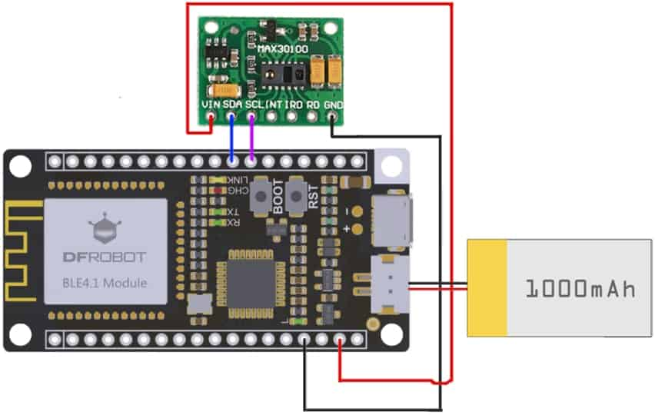
MAX30100 Board
￼
￼
￼

Slide 14
Working of MAX30100 Pulse Oximeter and Heart-Rate Sensor working
￼
￼
￼
What is oxygen saturation?
Red blood cells contain haemoglobin which carries oxygen. When haemoglobin is carrying oxygen it is described as “saturated with oxygen”
Lung-Circulation Unit
the lung and upper airway and the pulmonary blood flowing through the lungs.
Oxygen in the air is breathed into the lung; carbon dioxide is breathed out

Slide 15
Working of MAX30100 Pulse Oximeter and Heart-Rate Sensor working
￼
￼
￼
Lung-Circulation Unit
Venous blood from the tissues has delivered some of its oxygen to the tissues. Normally only 75% of the haemoglobin of venous blood is saturated with oxygen.
Blood is oxygenated in the lungs and is then pumped by the heart to the tissues. In arterial blood 98% of haemoglobin is saturated with oxygen. The colour of blood depends how much haemoglobin is saturated with oxygen. Arterial blood is fully saturated and is bright red; venous blood has less oxygen and is dark red.

Slide 16
Working of MAX30100 Pulse Oximeter and Heart-Rate Sensor working
￼
￼
￼
How does an oximeter work?
A pulse oximeter is composed of the sensor (or probe) and the monitor with the display. The probe is on the finger and is detecting the flow of blood through the finger. This is displayed as a pulse wave on the monitor. A pulse wave must be present to demonstrate that a pulse is being detected. In this figure, the patient has a pulse rate of 72 beats / minute and an SpO2 of 98%. This monitor describes the pulse rate as the heart rate.

Slide 17
Working of MAX30100 Pulse Oximeter and Heart-Rate Sensor working
￼
￼
￼
How does an oximeter work?
All pulse oximeter probes (finger or ear) have light emitting diodes (LEDs) which shine two types of red light through the tissue. The sensor on the other side of the tissue picks up the light that is transferred through the tissues. The oximeter can determine which of the haemoglobin is in pulsatile blood (arterial) and can then determine the SpO 2 of arterial blood in the peripheral circulation.

Slide 18
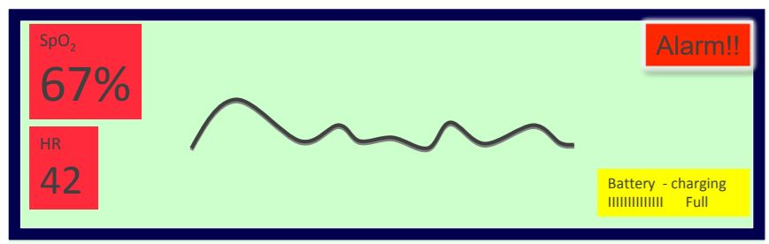
Working of MAX30100 Pulse Oximeter and Heart-Rate Sensor working
￼
￼
￼
The pulse rate is 42 beats/min but the SpO2 is only 67% representing dangerous hypoxia.
Here if the value goes down than 80 spo2 .the alert goes to the concern person through real time operating system

Slide 19
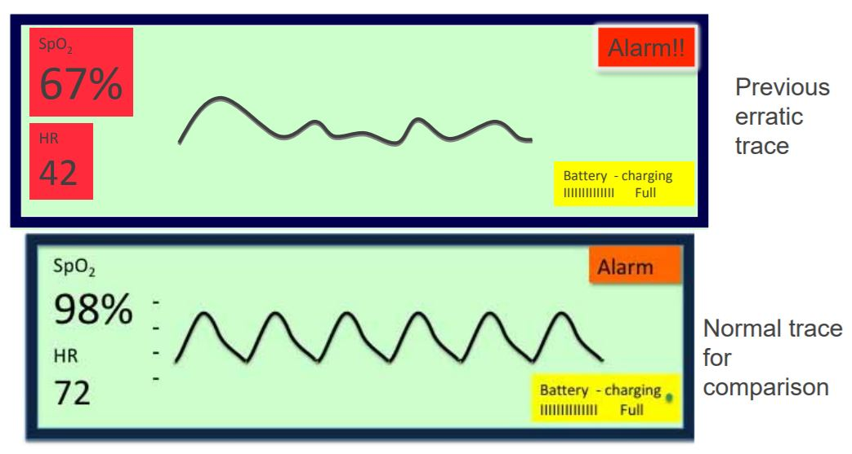
Working of MAX30100 Pulse Oximeter and Heart-Rate Sensor working
￼
￼
￼
Compare the last oximeter trace with the normal trace.

Slide 20
Source Code/Program
￼
￼
￼
/
#define BLYNK_PRINT Serial
#include <WiFi.h>
#include <WiFiClient.h>
#include <BlynkSimpleEsp32.h>
#include <Wire.h>
#include "MAX30105.h" //sparkfun MAX3010X library
#include "heartRate.h"
MAX30105 particleSensor;

Slide 21
Source Code/Program
￼
￼
￼
//#define MAX30105 //if you have Sparkfun's MAX30105 breakout board , try #define MAX30105
// You should get Auth Token in the Blynk App.
// Go to the Project Settings (nut icon).
char auth[] = "*****************************"; // Token you received on your email, Replace with stars
// Your WiFi credentials.
// Set password to "" for open networks.
char ssid[] = "******"; // Replace stars with Wifi Name/SSID
char pass[] = "******"; //Replace stars with Wifi Password

Slide 22
Source Code/Program
￼
￼
￼
double avered = 0; double aveir = 0;
double sumirrms = 0;
double sumredrms = 0;
int i = 0;
int Num = 100;//calculate SpO2 by this sampling interval

Slide 23
Source Code/Program
￼
￼
￼
double ESpO2 = 95.0;//initial value of estimated SpO2
double FSpO2 = 0.7; //filter factor for estimated SpO2
double frate = 0.95; //low pass filter for IR/red LED value to eliminate AC component
#define TIMETOBOOT 3000 // wait for this time(msec) to output SpO2
#define SCALE 88.0 //adjust to display heart beat and SpO2 in the same scale
#define SAMPLING 5 //if you want to see heart beat more precisely , set SAMPLING to 1
#define FINGER_ON 30000 // if red signal is lower than this , it indicates your finger is not on the sensor
#define MINIMUM_SPO2 80.0

Slide 24
Source Code/Program
￼
￼
const byte RATE_SIZE = 4; //Increase this for more averaging. 4 is good.
byte rates[RATE_SIZE]; //Array of heart rates
byte rateSpot = 0;
long lastBeat = 0; //Time at which the last beat occurred
float beatsPerMinute;
int beatAvg;
#define USEFIFO
void setup()
{
Serial.begin(115200);
Serial.println("Initializing...");
Blynk.begin(auth, ssid, pass);
// Initialize sensor
while (!particleSensor.begin(Wire, I2C_SPEED_FAST)) //Use default I2C port, 400kHz speed
{
Serial.println("MAX30102 was not found. Please check wiring/power/solder jumper at MH-ET LIVE MAX30102 board. ");
//while (1);
}

Slide 25
Source Code/Program
￼
￼
￼
//Setup to sense a nice looking saw tooth on the plotter
byte ledBrightness = 0x7F; //Options: 0=Off to 255=50mA
byte sampleAverage = 4; //Options: 1, 2, 4, 8, 16, 32
byte ledMode = 2; //Options: 1 = Red only, 2 = Red + IR, 3 = Red + IR + Green
//Options: 1 = IR only, 2 = Red + IR on MH-ET LIVE MAX30102 board
int sampleRate = 200; //Options: 50, 100, 200, 400, 800, 1000, 1600, 3200
int pulseWidth = 411; //Options: 69, 118, 215, 411
int adcRange = 16384; //Options: 2048, 4096, 8192, 16384
// Set up the wanted parameters
particleSensor.setup(ledBrightness, sampleAverage, ledMode, sampleRate, pulseWidth, adcRange); //Configure sensor with these settings
particleSensor.enableDIETEMPRDY();

Slide 26
Source Code/Program
￼
￼
￼
void loop()
{
uint32_t ir, red ;
double fred, fir;
double SpO2 = 0; //raw SpO2 before low pass filtered
#ifdef USEFIFO
particleSensor.check(); //Check the sensor, read up to 3 samples
while (particleSensor.available()) {//do we have new data
#ifdef MAX30105
red = particleSensor.getFIFORed(); //Sparkfun's MAX30105
ir = particleSensor.getFIFOIR(); //Sparkfun's MAX30105
#else
red = particleSensor.getFIFOIR(); //why getFOFOIR output Red data by MAX30102 on MH-ET LIVE breakout board
ir = particleSensor.getFIFORed(); //why getFIFORed output IR data by MAX30102 on MH-ET LIVE breakout board
#endif

Slide 27
Source Code/Program
￼
￼
￼
i++;
fred = (double)red;
fir = (double)ir;
avered = avered * frate + (double)red * (1.0 - frate);//average red level by low pass filter
aveir = aveir * frate + (double)ir * (1.0 - frate); //average IR level by low pass filter
sumredrms += (fred - avered) * (fred - avered); //square sum of alternate component of red level
sumirrms += (fir - aveir) * (fir - aveir);//square sum of alternate component of IR level
if ((i % SAMPLING) == 0) {//slow down graph plotting speed for arduino Serial plotter by thin out
if ( millis() > TIMETOBOOT) {

Slide 28
Source Code/Program
￼
￼
￼
float ir_forGraph = (2.0 * fir - aveir) / aveir * SCALE;
float red_forGraph = (2.0 * fred - avered) / avered * SCALE;
//trancation for Serial plotter's autoscaling
if ( ir_forGraph > 100.0) ir_forGraph = 100.0;
if ( ir_forGraph < 80.0) ir_forGraph = 80.0;
if ( red_forGraph > 100.0 ) red_forGraph = 100.0;
if ( red_forGraph < 80.0 ) red_forGraph = 80.0;
// Serial.print(red); Serial.print(","); Serial.print(ir);Serial.print(".");
if (ir < FINGER_ON) ESpO2 = MINIMUM_SPO2; //indicator for finger detached
float temperature = particleSensor.readTemperatureF();
Blynk.run();
Blynk.virtualWrite(V4,ESpO2 );
Serial.print(" Oxygen % = ");
Serial.println(ESpO2);
}
}

Slide 29
Source Code/Program
if ((i % Num) == 0) {
double R = (sqrt(sumredrms) / avered) / (sqrt(sumirrms) / aveir);
// Serial.println(R);
SpO2 = -23.3 * (R - 0.4) + 100; //http://ww1.microchip.com/downloads/jp/AppNotes/00001525B_JP.pdf
ESpO2 = FSpO2 * ESpO2 + (1.0 - FSpO2) * SpO2;//low pass filter
// Serial.print(SpO2);Serial.print(",");Serial.println(ESpO2);
sumredrms = 0.0; sumirrms = 0.0; i = 0;
break;
}
particleSensor.nextSample(); //We're finished with this sample so move to next sample
//Serial.println(SpO2);
}
#endif
}

Slide 30
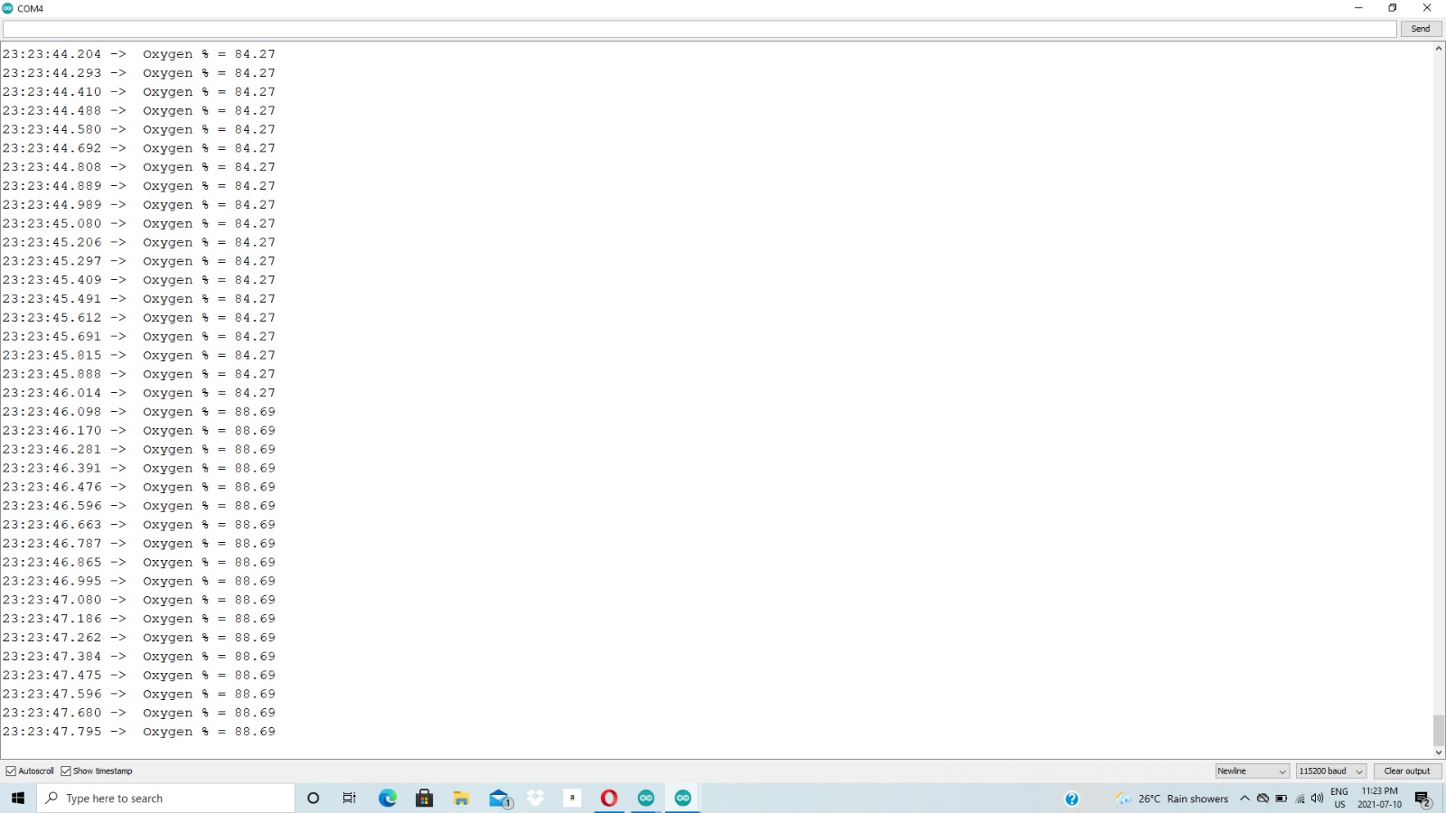
Output

Slide 31
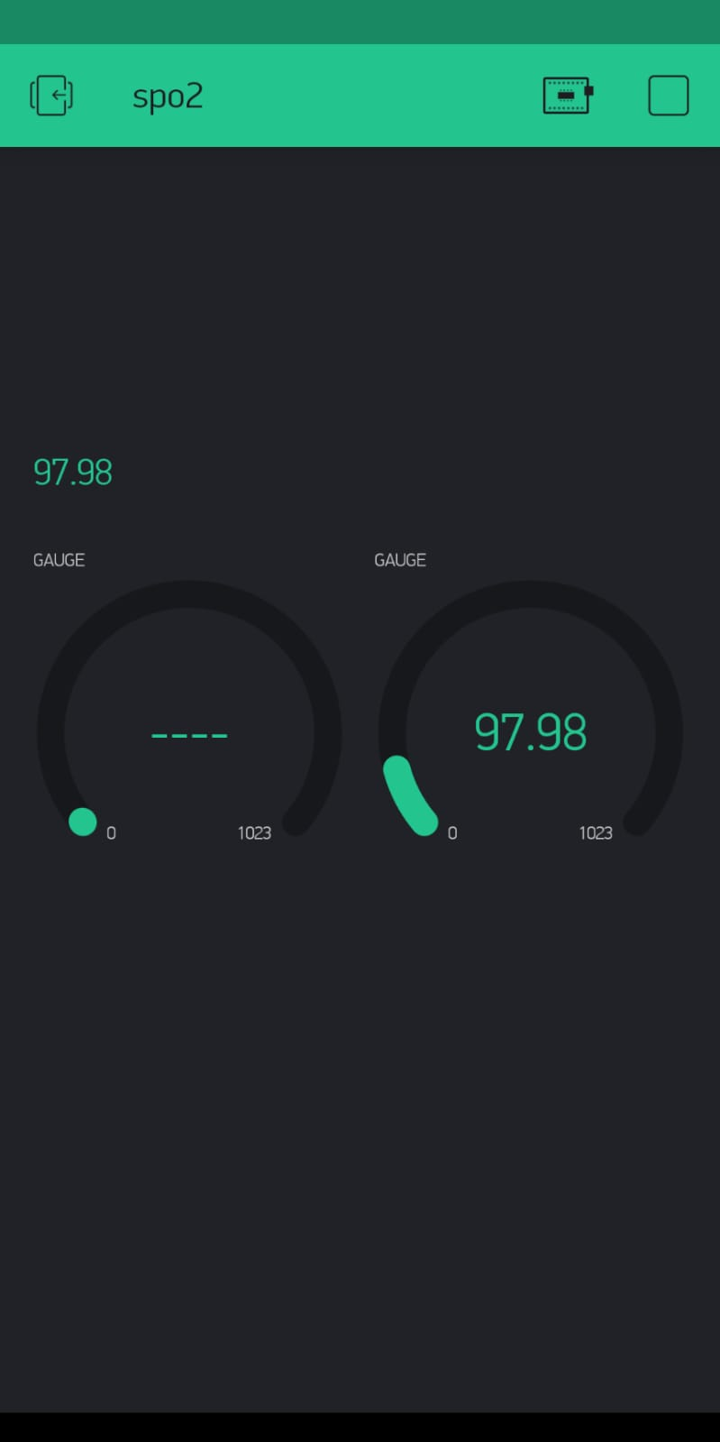
Output in blynk App

Slide 32
Connections
## Hardware Connections (ESP32 Arduino):
-VIN = 3.3V
-GND = GND
-SDA = 21 (or SDA)
-SCL = 22 (or SCL)

Slide 33
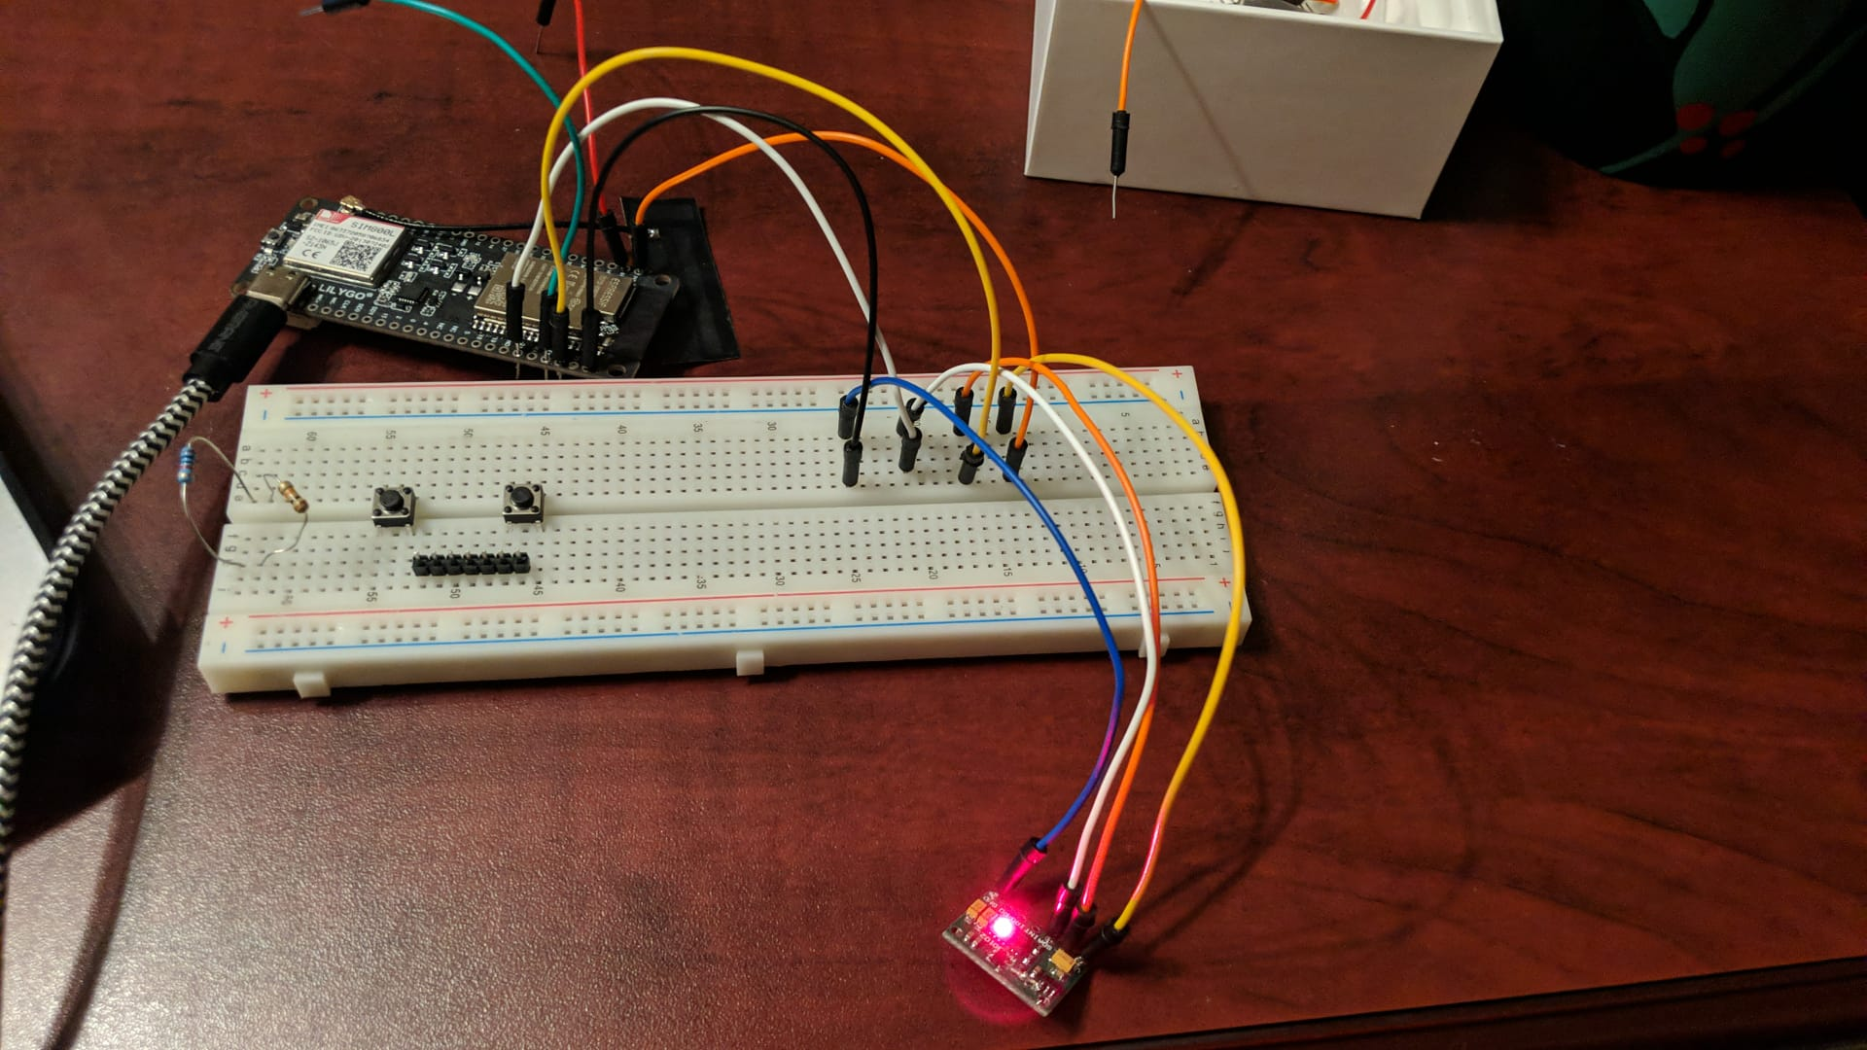
Connections

Slide 34
Conclusion
This is a brief about integrated pulse oximetry and heart-rate monitor sensor solution.with its hardware connections and software workings

Slide 35
References.
HOCKSTAR.IO(2017, September 21). DIY Blood Oximeter. https://www.hackster.io/rswm/diy-blood-oximeter-93529b
HOW TO ELECTRONICS. (n.d.). Monitor SpO2/BPM with ESP32 & MAX30100 Pulse Oximeter on Blynk https://how2electronics.com/esp32-max30100-pulse-oximeter-blynk/

Slide 36
Thank you

